Slide 1
Introduction to Hacking
Mike Housley
Chris Doyle
10/2019
Notes:
Git Hub:
Bookmarks list
Old Burp presentation
Current presentation

Slide 2
Permission
Make sure you have written permission to pen test the network, web application, mobile application and any related hardware, from the highest organizational personnel.
Warn other teams that might not know about your security test, before alarms are set off.
Stay within the defined scope, do not test domains, services, hardware, or software that is not in scope.

Slide 3
Useful Links
Operating Systems with hacking tools
Kali Linux: https://www.kali.org/downloads/
Parrot OS: https://parrotlinux.org/download-security.php
Virtual Machines
Samurai Dojo: https://sourceforge.net/projects/samurai/files/latest/download?source=files
Vuln Hub: https://www.vulnhub.com/
Tools
SecLists: https://github.com/danielmiessler/SecLists
Burp Suite: https://portswigger.net/burp
Impacket: https://github.com/SecureAuthCorp/impacket
Kali Meta Packages: https://tools.kali.org/kali-metapackages
Katoolin: https://github.com/LionSec/katoolin
Notes:
Burp Suite – proxy tool to modify requests and responses
Impacket – python tools that can aid with exploits, and enumeration. Standup SMB server in local directory is one example
Katoolin – Will allow easy installation of kali tools on other operating systems – Ubuntu, Raspian, etc
SecLists – can also be installed with apt install secLists in Kali linux

Slide 4
Basic Security – Do The Needful
Change the default password of “toor” to something more secure
Open a Terminal, Type “passwd” and then enter a new password twice.
# passwd
Change the default SSH keys
# mkdir /etc/ssh/backup-keys
# mv /etc/ssh/ssh_host_* /etc/ssh/backup-keys
Validate SSH Keys are different
# md5sum /etc/ssh/ssh_host_*
# md5sum /etc/ssh/backup-keys/ssh_host_*
Delete old SSH keys
# rm –fR /etc/ssh/backup-keys

Slide 5
Workflow
Information Gathering
Application Workflows
Automated & Manual Fuzzing/Scanning
Exploiting Vulnerabilities
Notes:
Information Gathering stage: Passive and non-passive methods. Looking for email addresses, how names are used, phone numbers, dns site maps, any useful information that could be leveraged during the pen test.
Application Workflows: Mapping all web services, web pages, finger printing of technologies used.
Automated and Manual Fuzzing: Use automated scanners to quickly find possible attack vectors. Manually fuzz parameters and validate automated scan results. Any forced directory/file browsing would happen here.
Exploit: Prove that the vulnerability exits and could potentially be used. The vulnerability would then be recorded for the findings report that also links back to the OWASP top 10, NIST, or CVE list.

Slide 6
TheHarvester
OSINT: Opensource Intelligence tool that attempts to get emails, names, subdomains, IPs, and URLs using multiple public data sources.
Scans the following public sources:
baidu, bing, bingapi, certspotter, crtsh, dnsdumpster, dogpile, duckduckgo, github-code, google, hunter, intelx, linkedin, linkedin_links, netcraft, otx, securityTrails, spyse(disabled for now), threatcrowd, trello, twitter, vhost, virustotal, yahoo, all
Some sources require API keys:
googleCSE, hunter, intelx, securityTrails,shodan
# theHarvester -d americanbar.org -b baidu,bing,certspotter,dnsdumpster,dogpile,duckduckgo,google,hunter,linkedin,netcraft,threatcrowd,trello,twitter,virustotal,yahoo -f americanbar_org_harvest
Notes:
*******************************************************************
* _ _ _ *
* | |_| |__ ___ /\ /\__ _ _ ____ _____ ___| |_ ___ _ __ *
* | __| _ \ / _ \ / /_/ / _` | '__\ \ / / _ \/ __| __/ _ \ '__| *
* | |_| | | | __/ / __ / (_| | | \ V / __/\__ \ || __/ | *
* \__|_| |_|\___| \/ /_/ \__,_|_| \_/ \___||___/\__\___|_| *
* *
* theHarvester 3.1.0 *
* Coded by Christian Martorella *
* Edge-Security Research *
* cmartorella@edge-security.com *
* *
*******************************************************************
[*] Target: americanbar.org
[*] Searching Baidu.
[*] Searching Bing.
[*] Searching CertSpotter.
Searching results.
[*] Searching DNSdumpster.
[*] Searching Dogpile.
[*] Searching DuckDuckGo.
[*] Searching Google.
Searching 0 results.
Searching 100 results.
Searching 200 results.
Searching 300 results.
Searching 400 results.
Searching 500 results.
[*] Searching Hunter.
[*] Searching Linkedin.
Searching 100 results.
Searching 200 results.
Searching 300 results.
Searching 400 results.
Searching 500 results.
[*] No users found Linkedin.
[*] Searching Netcraft.
[*] Searching Threatcrowd.
Searching results.
[*] Searching Trello.
Searching 0 results.
[*] Searching Twitter usernames using Google.
[*] No users found.
[*] Searching VirusTotal.
Searching results.
[*] Searching Yahoo.
[*] No IPs found.
[*] Emails found: 8
----------------------
abairr@americanbar.org
abalegalfactcheck@americanbar.org
abapresident@americanbar.org
info@nativeamericanbar.org
info@philippineamericanbar.org
patrice.payne@americanbar.org
tanya.terrell@americanbar.org
[*] Hosts found: 113
---------------------
[*] No Trello URLs found.
[*] Reporting started.
[*] Reporting finished.
[*] Saving files.
[*] Files saved.

Slide 7
Recon-ng OSINT
# recon-ng
List modules that can be installed
[recon-ng][default] > marketplace search
Install module
[recon-ng][default] > marketplace install whois_pocs
Load module
[recon-ng][default] > modules load whois_pocs
Get information about module
[recon-ng][default][whois_pocs] > info

Slide 8
Recon-ng OSINT
Set required options for the module
[recon-ng][default][whois_pocs] > options set SOURCE americanbar.org
Run the module
[recon-ng][default][whois_pocs] > run
Use the show command to see database contents
show contacts

Slide 9
Netcat - Discovery
Scan for open TCP ports
# nc -nvv -w1 -z 10.10.100.1 20-1000
Scan for open UDP ports
# nc -nvv -w1 -u 10.10.100.1 53-1000
-h display help for netcat options
-n numeric-only IP addresses, no DNS
-v verbose [use twice to be more verbose]
-w timeout for connects and final net reads
-z zero-I/O mode [used for scanning]
Notes:
Can be combined with a simple bash for loop to check multiple IP addresses

Slide 10
Netcat - Output
Port is open
# nc -nvv -w1 -z 172.217.14.238 443
(UNKNOWN) [172.217.14.238] 443 (https) open
sent 0, rcvd 0
Port may be closed or is filtered
# nc -nvv -w1 -z 127.0.0.1 21
(UNKNOWN) [127.0.0.1] 21 (ftp) : Connection refused
sent 0, rcvd 0

Slide 11
Netcat – Bash Loop
Loop through part of a subnet
# vi nc_portscan
Use “i” to insert the text below and then save file with shift + zz
#!/bin/bash
for ip in $(seq 1 100); do
for port in $(seq 21 443); do
nc -nvv -w1 -z 10.10.100.$ip $port 2>&1 | grep open
done
done
Run script and view output – this method is slow
# sh nc_portscan
Notes:
Note you can chmod the script to make it executeable:
# chmod +x nc_portscan
Run script:
# ./nc_portscan

Slide 12
Netcat – Bash Loop Improved
Faster bash script. Netcat launches once instance of netcat per IP instead of per port
#!/bin/bash
for ip in $(seq 156 157); do
nc -nvv -w1 -z 45.33.32.$ip 22-80 2>&1 | grep open
done
# ./nc_portscan
(UNKNOWN) [45.33.32.156] 80 (http) open
(UNKNOWN) [45.33.32.157] 80 (http) open

Slide 13
Nmap
TCP Connect scan with top 1000 ports
# nmap -sT 45.33.32.156
Scan all ports
# nmap -sT 45.33.32.156 –p 1-65535
Scan network range – also supports CIDR notation 10.0.0.0/24
# nmap –v –sn 10.0.0.0-255
Notes:
-sn ping scan, does not port scan

Slide 14
Nmap - Output
Starting Nmap 7.80 ( https://nmap.org ) at 2019-10-19 02:35 EDT
Nmap scan report for scanme.nmap.org (45.33.32.156)
Host is up (1.0s latency).
Not shown: 996 closed ports
PORT STATE SERVICE
22/tcp open ssh
80/tcp open http
9929/tcp open nping-echo
31337/tcp open Elite

Slide 15
Nmap – Common Switches
-A Enable OS detection, version detection, script scanning, and traceroute
-O Enable OS detection
-sV Probe open ports to determine service/version info
-sS TCP SYN scan
-sT TCP Connect() scan
-sA TCP ACK scan
-sU UDP Scan
-v Increase verbosity level (use -vv or more for greater effect)
-sn Ping Scan - disable port scan
-Pn Treat all hosts as online -- skip host discovery

Slide 16
SMB Discovery - nbtscan
# nbtscan -r 127.0.0.1
Doing NBT name scan for addresses from 127.0.0.1
IP address NetBIOS Name Server User MAC address
------------------------------------------------------------------------------
127.0.0.1 <unknown> <unknown>
Notes:
Ports 139, 445

Slide 17
SMB Discovery - rpcclient
# rpcclient -U “” windows_IP_address your_ip_address
Enter ‘s password: Press Enter key without typing a password
rpcclient $> srvinfo Get OS version
rpcclient $> enumdomusers List users on server
rpcclient $> enumdomgroups List groups on server
rpcclient $> getdompwinfo Get password policy
rpcclient $> querygroup 0x204 Get info on specified group
rpcclient $> querygroupmem 0x204 List users in group
rpcclient $> queryuser 0x3e8 Get info on specified user
Notes:
See the man page for all available rpcclient commands

Slide 18
SMB Discovery - Nmap
# nmap -v -p 139,445 127.0.0.1
Starting Nmap 7.80 ( https://nmap.org ) at 2019-10-19 02:59 EDT
Initiating SYN Stealth Scan at 02:59
Scanning localhost (127.0.0.1) [2 ports]
Discovered open port 139/tcp on 127.0.0.1
Discovered open port 445/tcp on 127.0.0.1
Completed SYN Stealth Scan at 02:59, 0.03s elapsed (2 total ports)
Nmap scan report for localhost (127.0.0.1)
Host is up (0.00017s latency).
PORT STATE SERVICE
139/tcp open netbios-ssn
445/tcp open microsoft-ds

Slide 19
SMB Discovery – Nmap SMB script
# nmap -v -p 139,445 127.0.0.1 --script=smb-os-discovery
PORT STATE SERVICE
139/tcp open netbios-ssn
445/tcp open microsoft-ds
Host script results:
| smb-os-discovery:
| OS: Windows 6.1 (Samba 4.9.11-Debian)
| Computer name: kali
| NetBIOS computer name: KALI\x00
| Domain name: \x00
| FQDN: kali
|_ System time: 2019-10-19T03:06:40-04:00

Slide 20
SMB Discovery – Enum4linux
# enum4linux 127.0.0.1
Starting enum4linux v0.8.9 ( http://labs.portcullis.co.uk/application/enum4linux/ ) on Sat Oct 19 03:01:59 2019
==========================
| Target Information |
==========================
Target ........... 127.0.0.1
RID Range ........ 500-550,1000-1050
Username ......... ''
Password ......... ''
Known Usernames .. administrator, guest, krbtgt, domain admins, root, bin, none

Slide 21
SNMP Discovery - Nmap
# nmap -sU --open -p 161 127.0.0.1 --script=snmp-info
Starting Nmap 7.80 ( https://nmap.org ) at 2019-10-19 03:18 EDT
Nmap scan report for localhost (127.0.0.1)
Host is up (0.0037s latency).
PORT STATE SERVICE
161/udp open snmp
| snmp-info:
| enterprise: net-snmp
| engineIDFormat: unknown
| engineIDData: 197d5c67b6b8aa5d00000000
| snmpEngineBoots: 1
|_ snmpEngineTime: 37s

Slide 22
SNMP OIDs
Windows RUNNING PROCESSES 1.3.6.1.2.1.25.4.2.1.2
Windows INSTALLED SOFTWARE 1.3.6.1.2.1.25.6.3.1.2
Windows SYSTEM INFO 1.3.6.1.2.1.1.1
Windows HOSTNAME 1.3.6.1.2.1.1.5
Windows DOMAIN 1.3.6.1.4.1.77.1.4.1
Windows UPTIME 1.3.6.1.2.1.1.3
Windows USERS 1.3.6.1.4.1.77.1.2.25
Windows SHARES 1.3.6.1.4.1.77.1.2.27
Windows DISKS 1.3.6.1.2.1.25.2.3.1.3
Windows SERVICES 1.3.6.1.4.1.77.1.2.3.1.1
Windows LISTENING TCP PORTS 1.3.6.1.2.1.6.13.1.3.0.0.0.0
Windows LISTENING UDP PORTS 1.3.6.1.2.1.7.5.1.2.0.0.0.0

Slide 23
SNMP Discovery - SNMPWalk
# snmpwalk -c public -v1 127.0.0.1
iso.3.6.1.2.1.1.1.0 = STRING: "Linux kali 5.2.0-kali2-amd64 #1 SMP Debian 5.2.9-2kali1 (2019-08-22) x86_64"
iso.3.6.1.2.1.1.2.0 = OID: iso.3.6.1.4.1.8072.3.2.10
iso.3.6.1.2.1.1.3.0 = Timeticks: (13528) 0:02:15.28
iso.3.6.1.2.1.1.4.0 = STRING: "Me <me@example.org>"
iso.3.6.1.2.1.1.5.0 = STRING: "kali"
iso.3.6.1.2.1.1.6.0 = STRING: "Sitting on the Dock of the Bay"
iso.3.6.1.2.1.1.7.0 = INTEGER: 72
iso.3.6.1.2.1.1.8.0 = Timeticks: (1) 0:00:00.01
Notes:
/etc/snmp/snmpd.conf:
sysLocation STRING: "Sitting on the Dock of the Bay"
sysContact STRING: "Me <me@example.org>”
Install MIBs and enable names instead of OIDs in returns
apt install snmp-mibs-downloader
Vi /etc/snmp/snmp.conf
Comment out the Mibs : line and save the file
# snmpwalk -c public -v1 127.0.0.1
SNMPv2-MIB::sysDescr.0 = STRING: Linux kali 5.2.0-kali3-amd64 #1 SMP Debian 5.2.17-1kali2 (2019-10-17) x86_64
SNMPv2-MIB::sysObjectID.0 = OID: NET-SNMP-MIB::netSnmpAgentOIDs.10
DISMAN-EVENT-MIB::sysUpTimeInstance = Timeticks: (81402) 0:13:34.02
SNMPv2-MIB::sysContact.0 = STRING: Me <me@example.org>
SNMPv2-MIB::sysName.0 = STRING: kali
SNMPv2-MIB::sysLocation.0 = STRING: Sitting on the Dock of the Bay
SNMPv2-MIB::sysServices.0 = INTEGER: 72
SNMPv2-MIB::sysORLastChange.0 = Timeticks: (2) 0:00:00.02

Slide 24
SNMP Discovery - SNMPEnum
# snmpenum 127.0.0.1 public /usr/share/snmpenum/linux.txt
----------------------------------------
UPTIME
----------------------------------------
4 minutes, 14.62
----------------------------------------
RUNNING SOFTWARE PATHS
----------------------------------------

Slide 25
FTP
When port 21 is open get the banner to see which FTP server is running
Try to login with anonymous/anonymous
Use Hydra or similar brute force username/password tool as last resort

Slide 26
SMTP
Get the banner of all email servers – exchange, pop3, imap
Use telnet to connect to the port
Use the VRFY command if it isn’t disabled to validate users

Slide 27
Vulnerability Scanning – Nmap
NSE scripts: https://svn.nmap.org/nmap/scripts
Locate where NSE scripts are stored
# find / -name *.nse
# locate *.nse
Place downloaded scripts in the directly listed above.
Default script folder /usr/share/nmap/scripts .nse files go here
Default Lib folder /usr/share/nmap/lib - .lua files go here
After adding files you need to update the database
# nmap --script-updated

Slide 28
Vulnerability Scanning – Nmap
Be cautious when running Nmap scripts they can easily break servers
Some scripts will need to set the unsafe argument to run
--script-args=unsafe=1
Find scripts for vulnerability scanning
# ls –l /usr/share/nmap/scripts *vuln*
-rw-r--r-- 1 root root 7344 Aug 16 07:47 smb-vuln-ms17-010.nse
-rw-r--r-- 1 root root 4400 Aug 16 07:47 smb-vuln-regsvc-dos.nse
-rw-r--r-- 1 root root 6586 Aug 16 07:47 smb-vuln-webexec.nse
-rw-r--r-- 1 root root 14781 Aug 16 07:47 smtp-vuln-cve2010-4344.nse
-rw-r--r-- 1 root root 7719 Aug 16 07:47 smtp-vuln-cve2011-1720.nse
-rw-r--r-- 1 root root 7603 Aug 16 07:47 smtp-vuln-cve2011-1764.nse
-rw-r--r-- 1 root root 7058 Aug 16 07:47 vulners.nse

Slide 29
Vulnerability Scanning – Nmap
# nmap -v google.com -p 443 --script=ssl-enum-ciphers
| TLSv1.2:
| ciphers:
| TLS_ECDHE_ECDSA_WITH_AES_128_CBC_SHA (ecdh_x25519) - A
| TLS_ECDHE_RSA_WITH_AES_256_CBC_SHA (ecdh_x25519) - A
| TLS_ECDHE_RSA_WITH_AES_256_GCM_SHA384 (ecdh_x25519) - A
| TLS_ECDHE_RSA_WITH_CHACHA20_POLY1305_SHA256 (ecdh_x25519) - A
| TLS_RSA_WITH_3DES_EDE_CBC_SHA (rsa 2048) - C
| warnings:
| 64-bit block cipher 3DES vulnerable to SWEET32 attack

Slide 30
DNS Records
A – Maps the domain name to an IPv4 address
AAAA – Maps the domain name to an IPv6 address
CNAME – Canonical Name Record or Alias Record that specifies that one domain name is an alias of another canonical domain name. A record can be in another zone name.
MX – One or more mail servers for the domain name
TXT – Contains arbitrary data for the domain. SPF, DMARC are two examples
SRV – Contains the hostname and port number, of servers for specified services.
PTR - Resolves an IP address to a domain or host name, a reverse DNS lookup.

Slide 31
DNS - host
Resolve domain to IP address
# host americanbar.org
americanbar.org has address 45.60.122.186
americanbar.org has address 45.60.132.186
americanbar.org is an alias for americanbar.org.
americanbar.org has address 45.60.132.186
americanbar.org mail is handled by 10 americanbar-org.mail.protection.outlook.com.
PTR record resolve
# host 172.228.99.38
38.99.228.172.in-addr.arpa domain name pointer a172-228-99-38.deploy.static.akamaitechnologies.com.

Slide 32
DNS - host
Specify record type to return
# host -t ns americanbar.org
americanbar.org name server ns1.abanet.org.
americanbar.org name server auth1.dns.cogentco.com.
americanbar.org name server ns2.abanet.org.
americanbar.org name server auth4.dns.cogentco.com.

Slide 33
DNS - host
Zone transfer from unprotected nameserver
# host -l -a americanbar.org ns1.abanet.org
Using domain server:
Name: ns1.abanet.org
Address: 38.99.228.188#53
Aliases:
ev.americanbar.org name server anubis2.abanet.org.
em.americanbar.org has address 13.111.18.27
click.em.americanbar.org has address 13.111.119.164
cloud.em.americanbar.org has address 13.111.118.235
mta.em.americanbar.org has address 13.111.112.184

Slide 34
DNS - dig
Record look up
# dig americanbar.org -t any
Lookup specifying nameserver
# dig @ns1.abanet.org americanbar.org -t cname
PTR record lookup
# dig -x 172.228.99.38
Zone transfer
# dig @ns1.abanet.org americanbar.org -t axfr
SRV record lookup
dig _sipfederationtls._tcp.americanbar.org -t srv

Slide 35
DNS - dnsrecon
# dnsrecon -d americanbar.org -t axfr
[*] Testing NS Servers for Zone Transfer
[*] Checking for Zone Transfer for americanbar.org name servers
[*] Resolving SOA Record
[*] Resolving NS Records
[*] Trying NS server 38.99.228.188
[+] 38.99.228.188 Has port 53 TCP Open
[+] Zone Transfer was successful!!
[*] SOA ns2.abanet.org 38.99.228.178

Slide 36
DNS - dnsenum
# dnsenum americanbar.org
dnsenum VERSION:1.2.4
----- americanbar.org -----
Host's addresses:
__________________
americanbar.org. 5 IN A 45.60.122.186
Trying Zone Transfers and getting Bind Versions:
_________________________________________________
Trying Zone Transfer for americanbar.org on ns1.abanet.org ...
americanbar.org. 3600 IN SOA

Slide 37
DNS - nslookup
# nslookup -type=a americanbar.org
Server: 192.168.104.2
Address: 192.168.104.2#53
Non-authoritative answer:
Name: americanbar.org
Address: 45.60.132.186
Name: americanbar.org
Address: 45.60.122.186
Notes:
# nslookup americanbar.org
# nslookup
> set type=ns
> americanbar.org
Server: 192.168.104.2
Address: 192.168.104.2#53
Non-authoritative answer:
americanbar.org nameserver = auth1.dns.cogentco.com.
americanbar.org nameserver = ns1.abanet.org.
americanbar.org nameserver = ns2.abanet.org.
americanbar.org nameserver = auth4.dns.cogentco.com.
Authoritative answers can be found from:
ns1.abanet.org internet address = 38.99.228.188
ns2.abanet.org internet address = 38.99.228.178
auth1.dns.cogentco.com internet address = 66.28.0.14
auth4.dns.cogentco.com internet address = 80.245.32.74
auth1.dns.cogentco.com has AAAA address 2001:550:1:a::d
auth4.dns.cogentco.com has AAAA address 2001:978:1:a::d

Slide 38
Whois - IP
# whois 45.60.122.186
NetRange: 45.60.0.0 - 45.60.255.255
CIDR: 45.60.0.0/16
NetName: INCAPSULA-NET

Slide 39
Whois – Domain Name
# whois americanbar.org
Domain Name: AMERICANBAR.ORG
Registry Domain ID: D16791045-LROR
Registrar WHOIS Server: whois.tucows.com
Registrar URL: http://www.tucows.com
Updated Date: 2019-01-16T07:56:48Z
Creation Date: 2000-01-07T16:28:52Z
Registry Expiry Date: 2020-01-07T16:28:52Z

Slide 40
Whois Via Telnet
telnet whois.tucows.com 43
Trying 64.99.62.11...
Connected to whois.opensrs.net.
Escape character is '^]'.
americanbar.org
Domain Name: AMERICANBAR.ORG
Registry Domain ID: D16791045-LROR
Registrar WHOIS Server: whois.tucows.com
Registrar URL: http://tucowsdomains.com
Updated Date: 2019-01-16T07:56:48

Slide 41
Man Pages and Apropos
# man host
# man nslookup
# man dig
# apropos dns
delv (1) - DNS lookup and validation utility
dig (1) - DNS lookup utility
dns2tcpc (1) - A tunneling tool that encapsulate TCP traffic over DNS.
dns2tcpd (1) - A tunneling tool that encapsulate TCP traffic over DNS.
dnsdomainname (1) - show the system's DNS domain name
dnsmasq (8) - A lightweight DHCP and caching DNS server.
dnsrecon (1) - DNS Enumeration and Scanning Tool

Slide 42
Banner Grabbing – Telnet
# telnet 162.241.50.205 21
Trying 162.241.50.205...
Connected to 162.241.50.205.
Escape character is '^]'.
220----- Welcome to Pure-FTPd [privsep] [TLS] ----------
220-You are user number 1 of 50 allowed.
# telnet 162.241.50.205 3306
Trying 162.241.50.205...
Connected to 162.241.50.205.
Escape character is '^]'.
J
5.7.26(
aDw0?Ymysql_native_passwordConnection closed by foreign host.

Slide 43
Telnet – WebPages
# telnet americanbar.org 80
Trying 45.60.132.186...
Connected to americanbar.org.
Escape character is '^]'.
HEAD / HTTP/1.1
Host: americanbar.org
HTTP/1.0 302 Moved Temporarily
Location: https://americanbar.org/
Server: BigIP
Connection: Keep-Alive
Content-Length: 0
Set-Cookie: visid_incap_144072=6SzXEklgTDGgG4ZEg0P8sU7Ht10AAAAAQUIPAAAAAACLnLu4Ux/dvasgj+Ji8tot; expires=Tue, 27 Oct 2020 08:11:14 GMT; path=/; Domain=.americanbar.org
Notes:
443 doesn’t allow enough time to copy/paste the Head/host lines before returning a timeout error.

Slide 44
Banner Grabbing - Curl
# curl -I https://americanbar.org
HTTP/1.1 301 Moved Permanently
Date: Mon, 28 Oct 2019 02:39:11 GMT
Server: Apache/2.4.6 (Red Hat Enterprise Linux)
Location: https://www.americanbar.org/
Cache-Control: max-age=1
Expires: Mon, 28 Oct 2019 02:39:12 GMT
Content-Type: text/html; charset=iso-8859-1
Set-Cookie: BIGipServerAEMweb=1526966464.20480.0000; path=/; Httponly; Secure

Slide 45
BIGIP – Information Disclosure
Information: https://support.f5.com/csp/article/K6917
# git clone https://github.com/psmet/BIGip-cookie-decoder.git
# cd BIGip-cookie-decoder/
# python BIGIP_decode_cookie.py BIGipServerAEMweb=1526966464.20480.0000
[*] Cookie to decode: BIGipServerAEMweb=1526966464.20480.0000
[*] Pool name: AEMweb
[*] Decoded IP and Port: 192.168.3.91:80

Slide 46
Useful Curl Arguments
--http0.9
--http1.0
--http1.1
--http2
--http3
-I HTTP Head method
-G HTTP GET method
-k Allow insecure SSL connection
-L Follow redirects
-X HTTP Method to use (i.e. TRACE)
-b --cookie Cookie to use
-c --cookie-jar Use Cookie Jar
-d --data HTTP POST body
-H Add Header
-i Include response headers in output

Slide 47
Vulnerability Databases
Exploit DB: https://www.exploit-db.com/exploits/47502
CVE: https://cve.mitre.org/cgi-bin/cvename.cgi?name=2019-14287
NIST: https://nvd.nist.gov/vuln/detail/CVE-2019-14287
Rapid7: https://www.rapid7.com/db/vulnerabilities/debian-cve-2019-14287
Vuln DB: https://vuldb.com/?id.143468
BugTraq: https://seclists.org/oss-sec/2019/q4/18
CxSecurity: https://cxsecurity.com/
Google Dorks: https://www.exploit-db.com/google-hacking-database

Slide 48
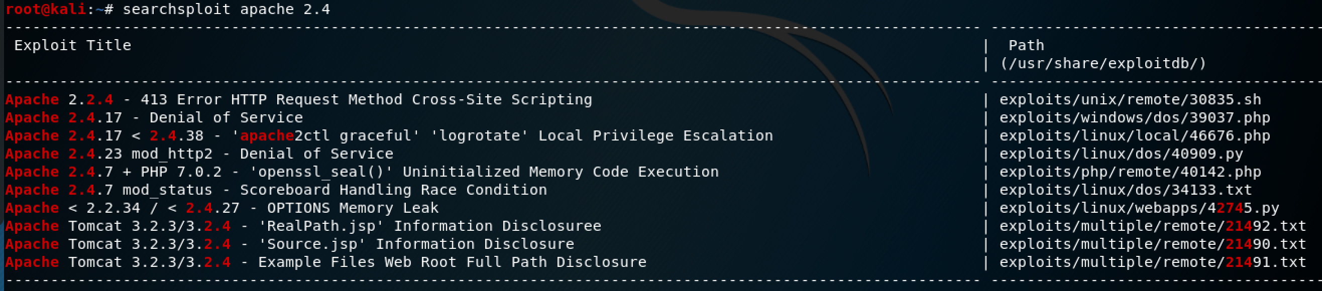
Exploit DB

Slide 49
Nikto
# nikto -host https://www.americanbar.org
+ Server: Apache/2.4.6 (Red Hat Enterprise Linux) + Cookie visid_incap_144072 created without the secure flag + Cookie visid_incap_144072 created without the httponly flag + Cookie incap_ses_975_144072 created without the secure flag + Cookie incap_ses_975_144072 created without the httponly flag
+ Entry ‘/tools/’ in robots.txt returned a non-forbidden or redirect HTTP code (302) + Entry ‘/auth/’ in robots.txt returned a non-forbidden or redirect HTTP code (200) + Entry ‘/claim/’ in robots.txt returned a non-forbidden or redirect HTTP code (200)
+ The Content-Encoding header is set to “deflate” this may mean that the server is vulnerable to the BREACH attack. + Apache/2.4.6 appears to be outdated (current is at least Apache/2.4.37). Apache 2.2.34 is the EOL for the 2.x branch.
Notes:
Nikto –H for all help items

Slide 50
Cewl
Scrape website for words to add to dictionaries. Useful for forced directory browsing and password cracking.
# cewl domain.com -w -c word_list.txt
and, 10210
the, 9041
arrow, 7709
MarkMonitor, 5028
your, 3725
brand, 3616
domain, 2898
Notes:
-w = write file
-c count number of word occurances

Slide 51
gobuster
Forced directory or file browsing
# gobuster dir -u http://dojo-basic -w /usr/share/secLists/Discovery/Web-Content/raft-large-directories-lowercase.txt -e -l -s ‘200,204,301,302,307,401,403,500’
Forced DNS or subdomain browsing
# gobuster dns -d markmonitor.com -w mm_wordlist

Slide 52
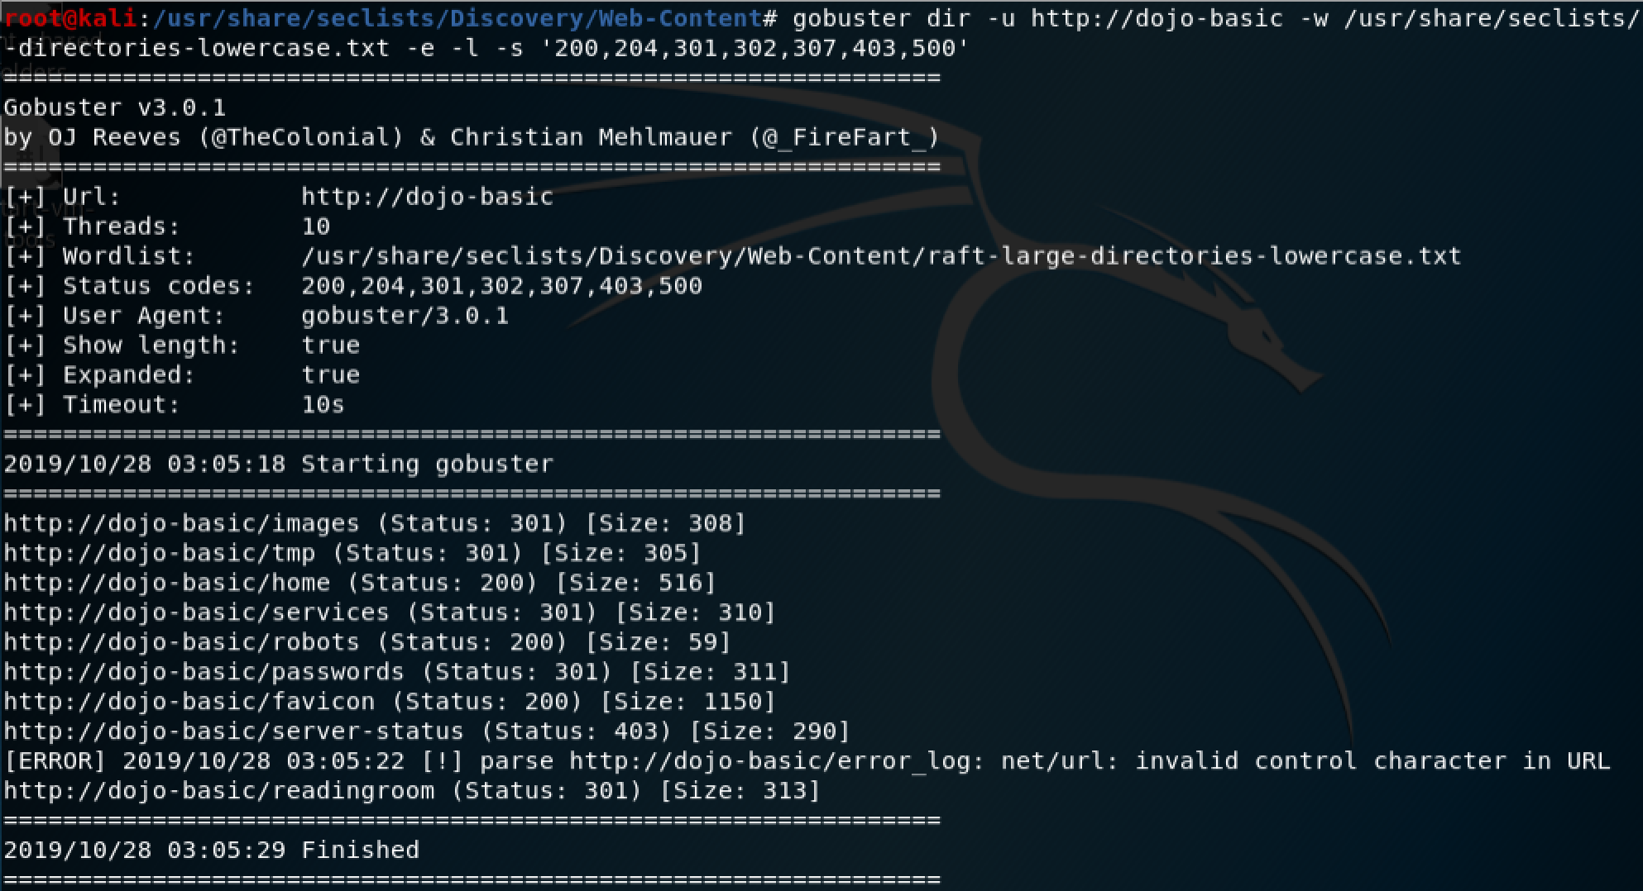

Slide 53
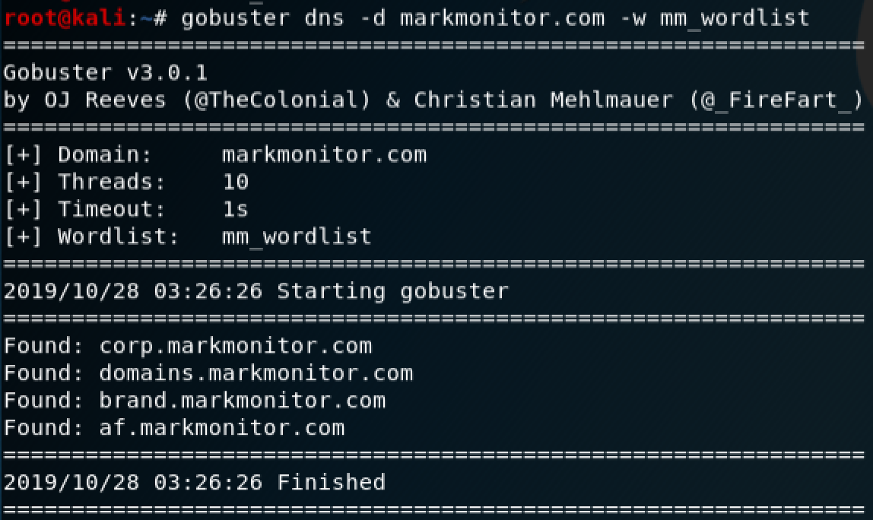

Slide 54
Dirbuster
GUI based tool that will recursively brute force directories and files
Launch the GUI from the command line
# dirbuster

Slide 55
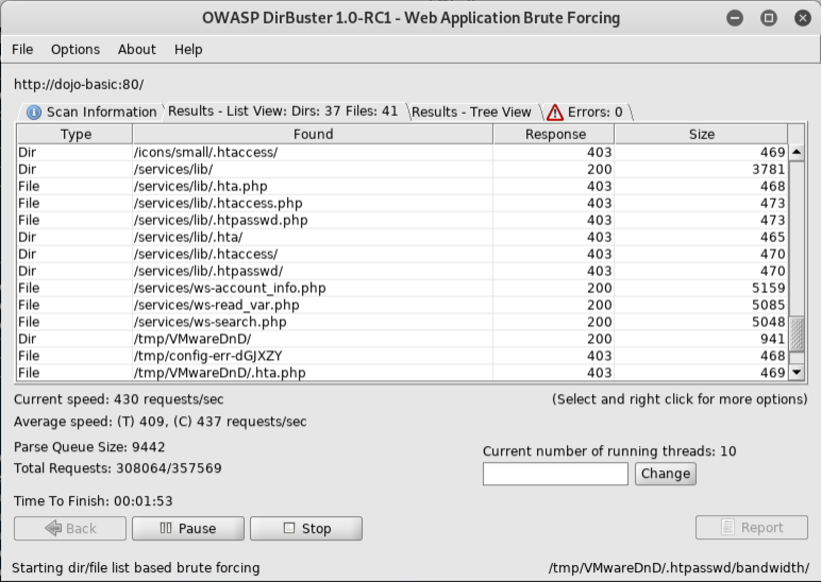

Slide 56
Dirb
Commandline tool similar to dirbuster
# dirb http://dojo-basic /usr/share/seclists/Discovery/Web-Content/common.txt

Slide 57
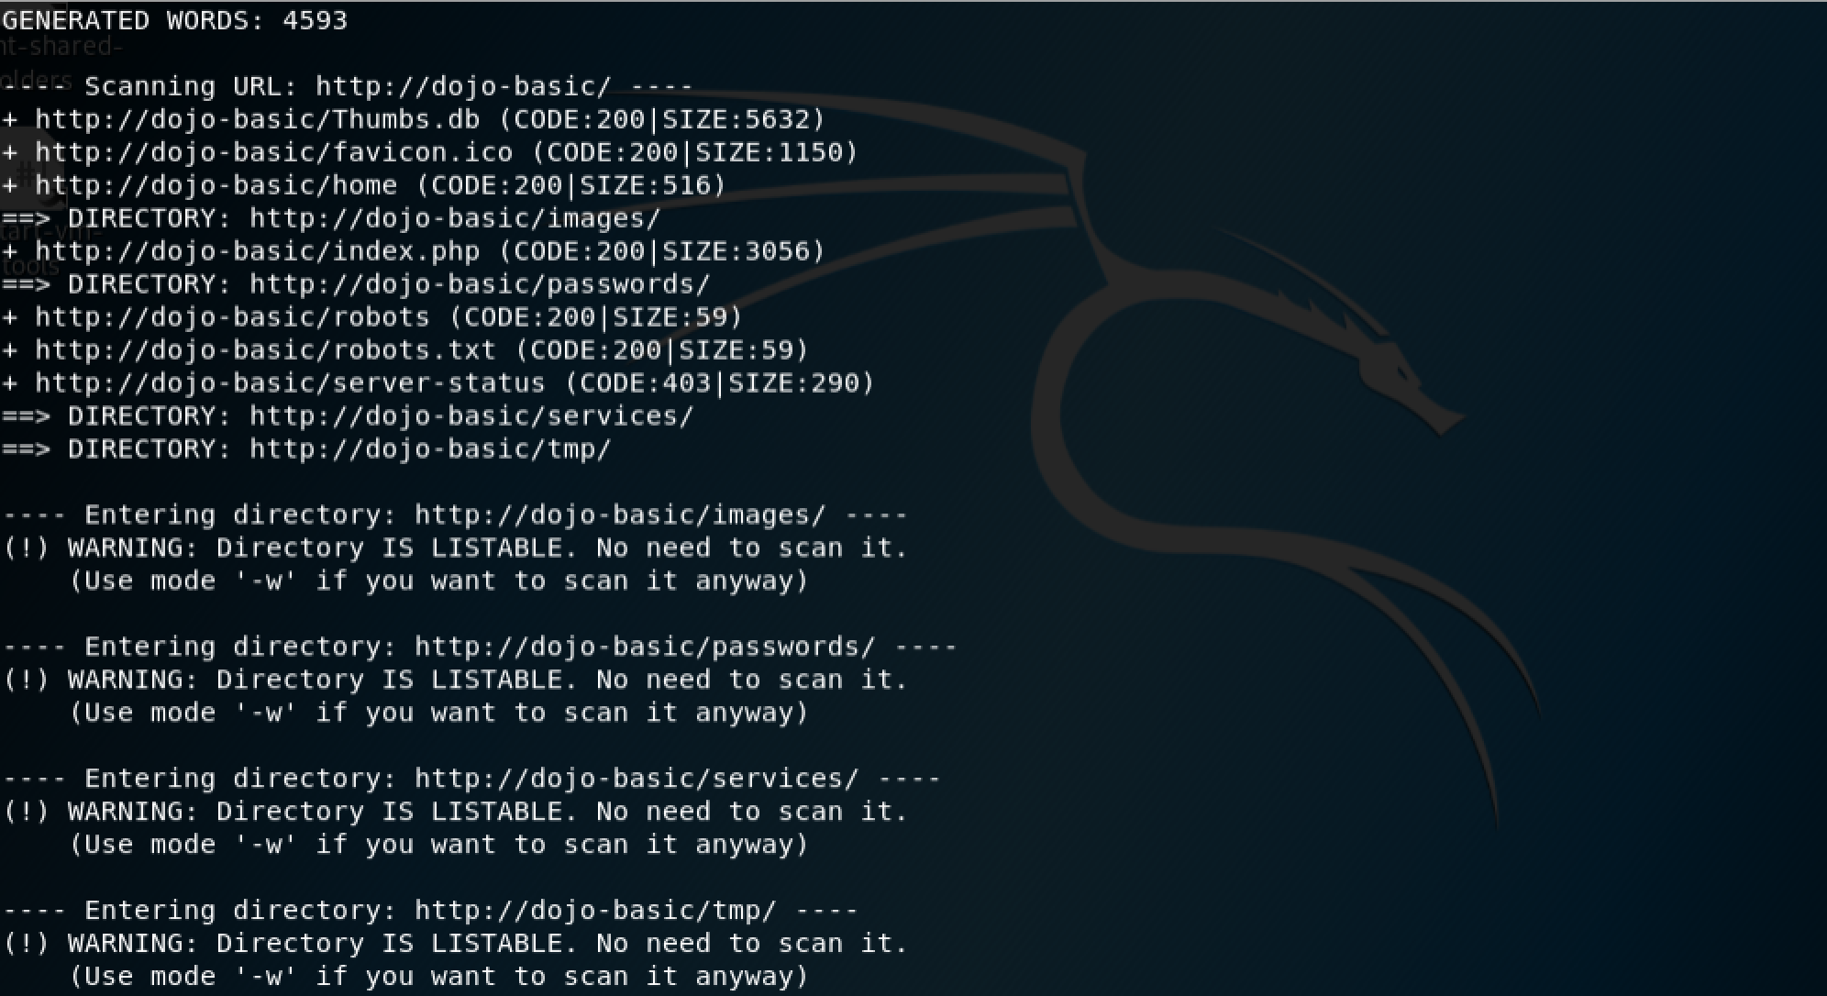

Slide 58
Burp Suite - Setup
Launch Burp Suite application
Select the Proxy tab and then the Options tab
Set the IP address and Port
Check the Running checkbox
Select the Intercept tab under Proxy
Click the Intercept is X button. The button label should say “Intercept is off”
In Browser: Edit->Preferences->General->Network Proxy->Settings
Select Manual proxy configuration
Set HTTP Proxy to: 127.0.01 Port: 8080
Check Use this proxy server for all protocols
Notes:
http://burp
Select CA Certificate, and then import the cert.der file as trusted authority certificate

Slide 59
Browse Web Application
In Browser navigate to http://dojo-basic
In Burp, select Target tab.
Right click on dojo-basic in the tree and click add to scope
Spider has been removed from the community edition so use ZAP, gobuster, dirbuster or similar tool to crawl the site. Hint, you can set the proxy in the command line for some tools so the tree tab is populated in Burp. If the tool doesn’t support proxy arguments Burp can also be ran as a SOCKS Proxy – User Options->Connections tab

Slide 60
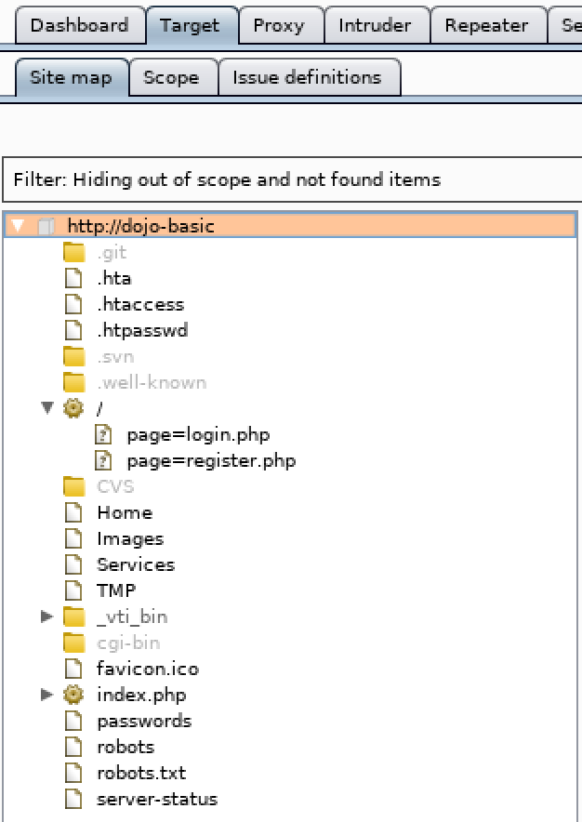
Spider – Gobuster With Proxy Through Burp Suite
# gobuster dir -u http://dojo-basic -w /usr/share/seclists/Discovery/Web-Content/common.txt -e -l -s '200,204,301,302,307,401,403,500' -p http://127.0.0.1:8082
View the tree tab inside Burp Suite.
Validate Show only in-scope items, and Hide not-found items are checked in the Filter for Target->Site Map

Slide 61
Headers – Root Of Site
# curl -I http://dojo-basic
HTTP/1.1 200 OK
Date: Wed, 30 Oct 2019 04:47:10 GMT
Server: Apache/2.4.7 (Ubuntu)
X-Powered-By: PHP/5.5.9-1ubuntu4.14
Content-Type: text/html

Slide 62
Browse HTML, JS, CSS Files
If using paid version of Burp Suite you can right click on a host in the tree and select Engagement Tools:
Find comments,
Find Scripts
Find References
For the community version manually view the responses or use curl and grep to look for comment strings
Look for useful information about the application, users, resources, network, etc

Slide 63
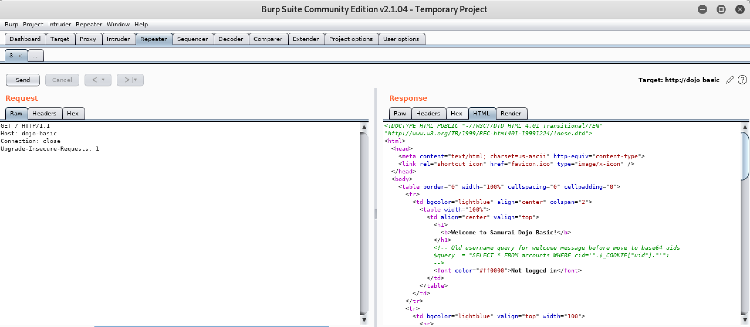
<!-- Old username query for welcome message before move to base64 uids
$query = "SELECT * FROM accounts WHERE cid='".$_COOKIE["uid"].”’”; -->
<!-- Check to see if admin is logged in and only show admin tool section if true -->
Notes:
Send the base/root web page request to the repeater tab for manual testing – CTRL+R CMD+R
Proxy->HTTP History select: http://dojo-basic GET / 200
Switch to the repeater tab
Request should look like:
GET / HTTP/1.1
Host: dojo-basic
User-Agent: Mozilla/5.0 (X11; Linux x86_64; rv:60.0) Gecko/20100101 Firefox/60.0
Accept: text/html,application/xhtml+xml,application/xml;q=0.9,*/*;q=0.8
Accept-Language: en-US,en;q=0.5
Accept-Encoding: gzip, deflate
Connection: close
Upgrade-Insecure-Requests: 1
Remove Accept* headers as they are needed

Slide 64
Browse Interesting files
View Target-> Site Map for interesting pages to look at
Using the Repeater tool or by looking at the robots response:
User-agent: *
Disallow: ./passwords/
Disallow: ./config.inc
Using the Repeater tool or by looking at the passwords/accounts.txt response:
'admin', 'adminpass', 'Monkey!!!
'adrian', 'somepassword', 'Zombie Films Rock!!!
'john', 'monkey', 'I like the smell of confunk
'ed', 'pentest', 'Commandline KungFu anyone?'

Slide 65
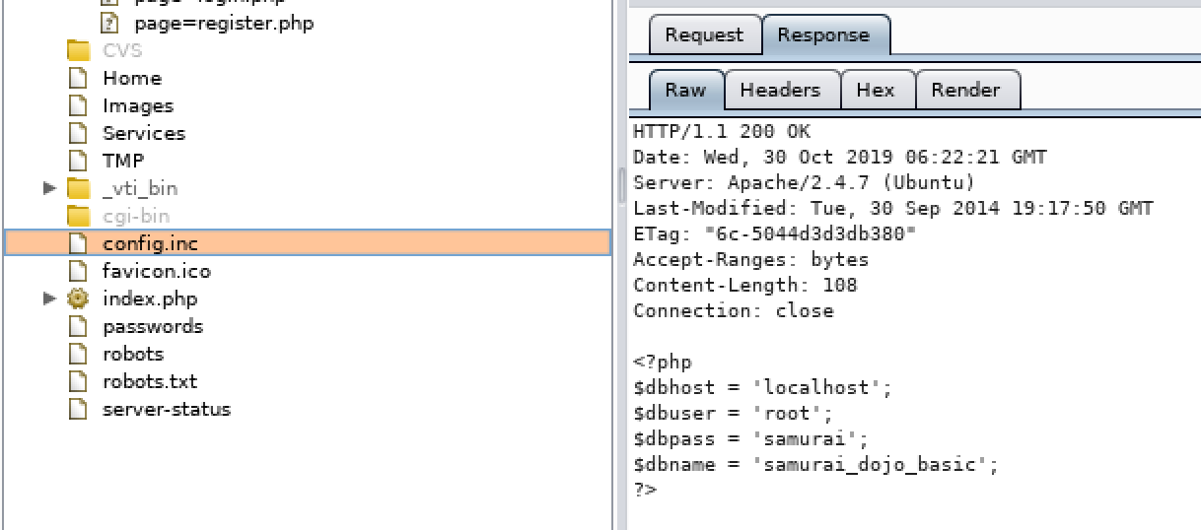
Browse Config.inc
Navigate to: http://dojo-basic/config.inc or edit path in Repeater (won’t show in site map)
Note that nothing is displayed on the page
In Burp Suite view the config.inc response

Slide 66
Fuzzing
A technique that involves providing invalid, unexpected or random data as input to a web application, form, or computer program.
Minimum/maximum length of input data | Directory Traversal
Invalid data type | Type juggling
Injecting JS, HTML, CSS | HTTP Methods
SQL Injections | Spoofing headers: referer, user-agent, cookie, x-forwarded-for, etc
Command Injections | URL parameter manipulation
Authentication bypass | Permission bypass
File uploads, executing macros | Page navigation – LFI/RFI

Slide 67
XSS
Allows javascript code to be ran inside the browser, injected by outside party.
Persistent XSS is stored in a database, file or cache.
Reflective XSS is not stored within in the application but is reflected back into the web application.
DOM XSS injected into the DOM
Examples:
<script>alert(“XSS Test”)</script>
‘/><script>alert(“XSS Element Test”)</script>
Notes:
Don’t forget to test headers, it is common to store referer, user-agent or any other custom headers
Also test hidden fields on forms

Slide 68
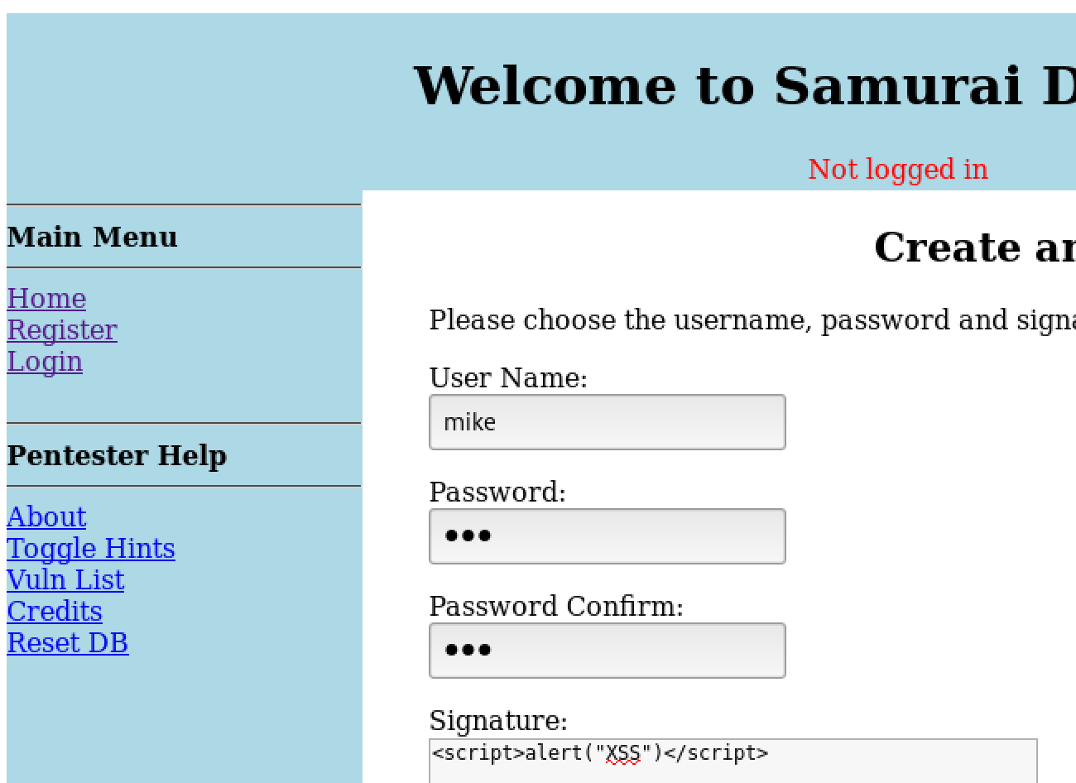
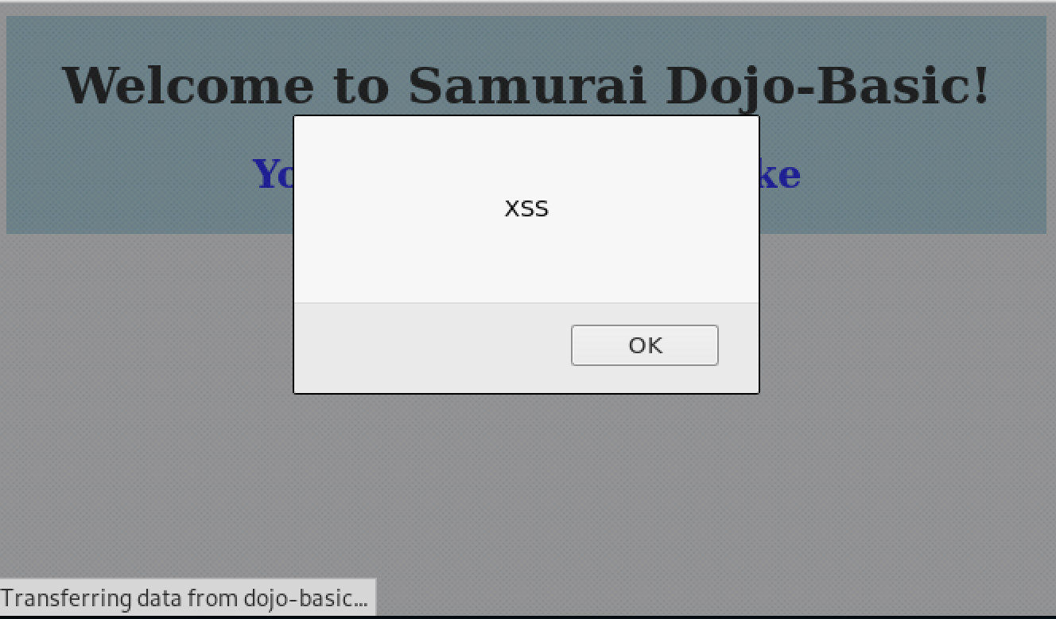
XSS

Slide 69
SQL Injection
Inject SQL statements into database queries to exfiltrate data, modify data, insert data, delete data, upload files or shells.
More information can be found:
https://www.owasp.org/index.php/SQL_Injection
https://www.websec.ca/kb/sql_injection
Non-blind SQL injection
Unsanitized input, lack of prepared statements
Blind SQL injection
Data isn’t directly revealed. Inferred by timing, error pages, HTTP responses
Out-of-band SQL injection
Relies on the database servers ability to make DNS or HTTP requests to deliver data.

Slide 70
SQL Injection Examples
See if input is sanitized
Input a single quote
True/False checks append to input string
Test’ and 1=1 --validate if something gets returned
Test’ and 1=2 -- validate nothing gets returned
Time based
test';waitfor delay '0:0:10’ – see if query returns in 10 seconds
Use error messages returned to help craft your SQL injection or get the correct number of columns for unions.
Notes:
Don’t forget to test headers, it is common to store referer, user-agent or any other custom headers

Slide 71
Command Injection
Inject OS commands from web application
View directory contents
target_host=google.com; ls –alR
View application user
target_host=google.com; whoami
Dump env variables
target_host=google.com;cat /proc/self/environ

Slide 72
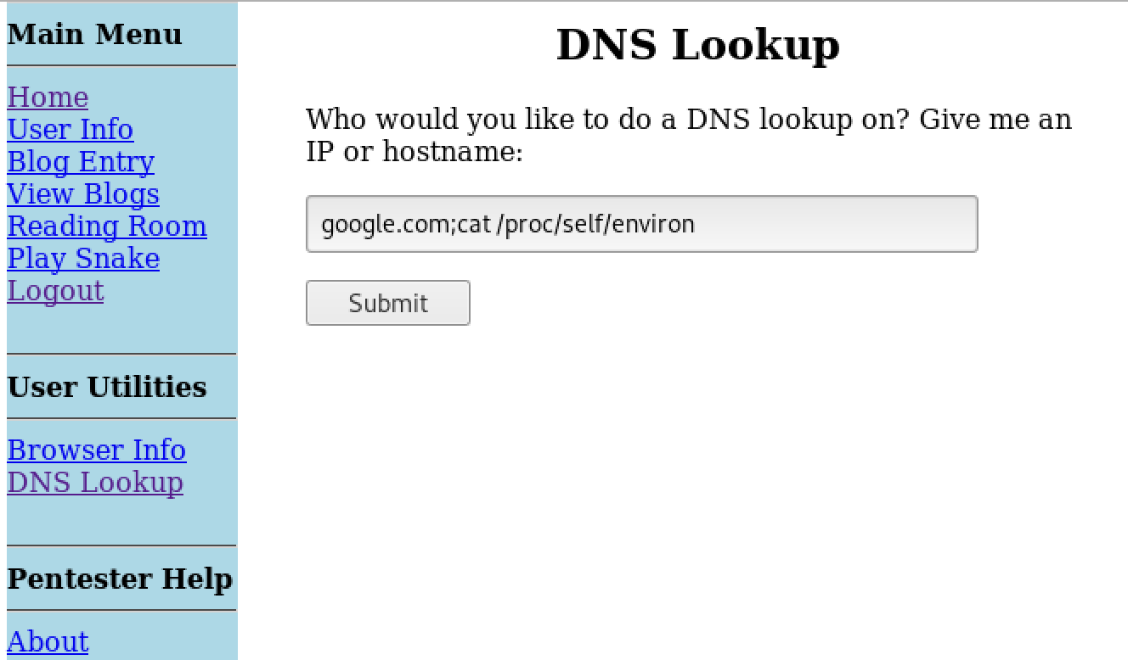
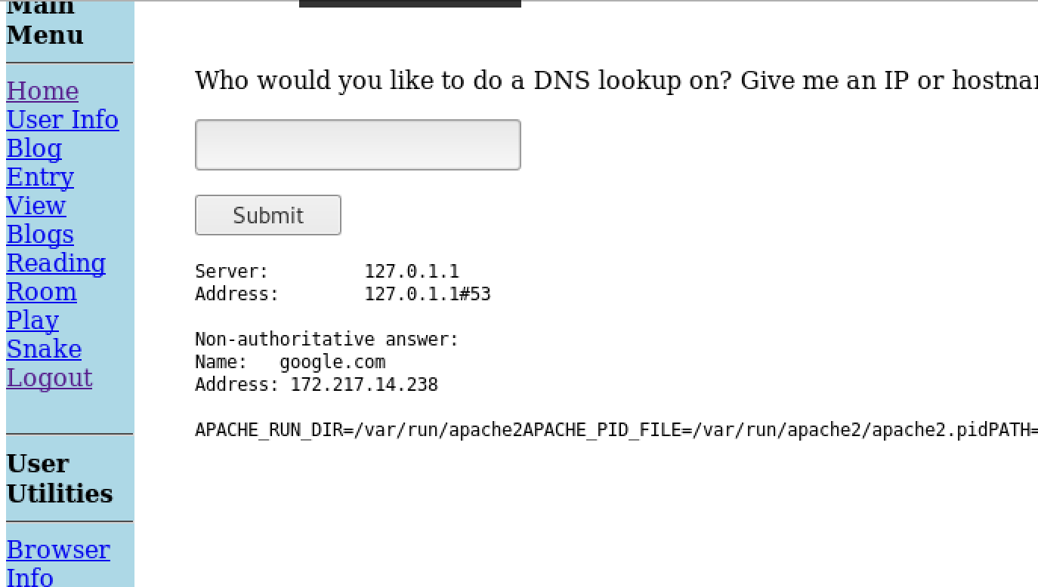
Command Injection
Notes:
Don’t forget to test headers, it is common to store referer, user-agent or any other custom headers
Look up Shell Shock for a good way to get command injection through headers on unpatched systems

Slide 73
Local File Inclusion LFI
The ability to include local files to use in attacks or to gather system information
List users and password hashes in Linux
http://dojo-basic/index.php?page=../../../../../../../etc/passwd
Get user password hashes
http://dojo-basic/index.php?page=../../../../../../../etc/shadow
Notes:
root:x:0:0:root:/root:/bin/bash daemon:x:1:1:daemon:/usr/sbin:/usr/sbin/nologin bin:x:2:2:bin:/bin:/usr/sbin/nologin sys:x:3:3:sys:/dev:/usr/sbin/nologin sync:x:4:65534:sync:/bin:/bin/sync games:x:5:60:games:/usr/games:/usr/sbin/nologin man:x:6:12:man:/var/cache/man:/usr/sbin/nologin lp:x:7:7:lp:/var/spool/lpd:/usr/sbin/nologin mail:x:8:8:mail:/var/mail:/usr/sbin/nologin news:x:9:9:news:/var/spool/news:/usr/sbin/nologin uucp:x:10:10:uucp:/var/spool/uucp:/usr/sbin/nologin proxy:x:13:13:proxy:/bin:/usr/sbin/nologin www-data:x:33:33:www-data:/var/www:/usr/sbin/nologin backup:x:34:34:backup:/var/backups:/usr/sbin/nologin list:x:38:38:Mailing List Manager:/var/list:/usr/sbin/nologin irc:x:39:39:ircd:/var/run/ircd:/usr/sbin/nologin gnats:x:41:41:Gnats Bug-Reporting System (admin):/var/lib/gnats:/usr/sbin/nologin nobody:x:65534:65534:nobody:/nonexistent:/usr/sbin/nologin libuuid:x:100:101::/var/lib/libuuid: syslog:x:101:104::/home/syslog:/bin/false messagebus:x:102:106::/var/run/dbus:/bin/false usbmux:x:103:46:usbmux daemon,,,:/home/usbmux:/bin/false dnsmasq:x:104:65534:dnsmasq,,,:/var/lib/misc:/bin/false avahi-autoipd:x:105:113:Avahi autoip daemon,,,:/var/lib/avahi-autoipd:/bin/false kernoops:x:106:65534:Kernel Oops Tracking Daemon,,,:/:/bin/false rtkit:x:107:114:RealtimeKit,,,:/proc:/bin/false saned:x:108:115::/home/saned:/bin/false whoopsie:x:109:116::/nonexistent:/bin/false speech-dispatcher:x:110:29:Speech Dispatcher,,,:/var/run/speech-dispatcher:/bin/sh avahi:x:111:117:Avahi mDNS daemon,,,:/var/run/avahi-daemon:/bin/false lightdm:x:112:118:Light Display Manager:/var/lib/lightdm:/bin/false colord:x:113:121:colord colour management daemon,,,:/var/lib/colord:/bin/false hplip:x:114:7:HPLIP system user,,,:/var/run/hplip:/bin/false pulse:x:115:122:PulseAudio daemon,,,:/var/run/pulse:/bin/false samurai:x:1000:1000:samurai,,,:/home/samurai:/bin/bash mysql:x:116:125:MySQL Server,,,:/nonexistent:/bin/false sshd:x:117:65534::/var/run/sshd:/usr/sbin/nologin kdm:x:118:65534::/home/kdm:/bin/false

Slide 74
Remote File Inclusion RFI
Execute files from a remote system within the application
http://dojo-basic/index.php?text_file_name=https://www.google.com
Look for URLs that are loading pages: page=contactus.php
Look for URLs that use full http requests: page=http://dojo-basic/services/login
Can possibly be used to upload remote shells to the server

Slide 75
SQLMap
Automates testing for SQL injections within applications
Run through proxy to learn how to better test for SQL Injections
# sqlmap -u 'http://dojo-basic:80/index.php?page=login.php' --data='user_name=admin&password=pass&Submit_button=Submit' --tables --dbs --proxy=http://127.0.0.1:8082
Install CO2 from Burp Extender to help form the syntax for SQLMap. Once all options are set, copy the SQLMap Command into the terminal .
Running SQLMap inside the CO2 plugin causes burp to be locked until SQLMap finishes.

Slide 76
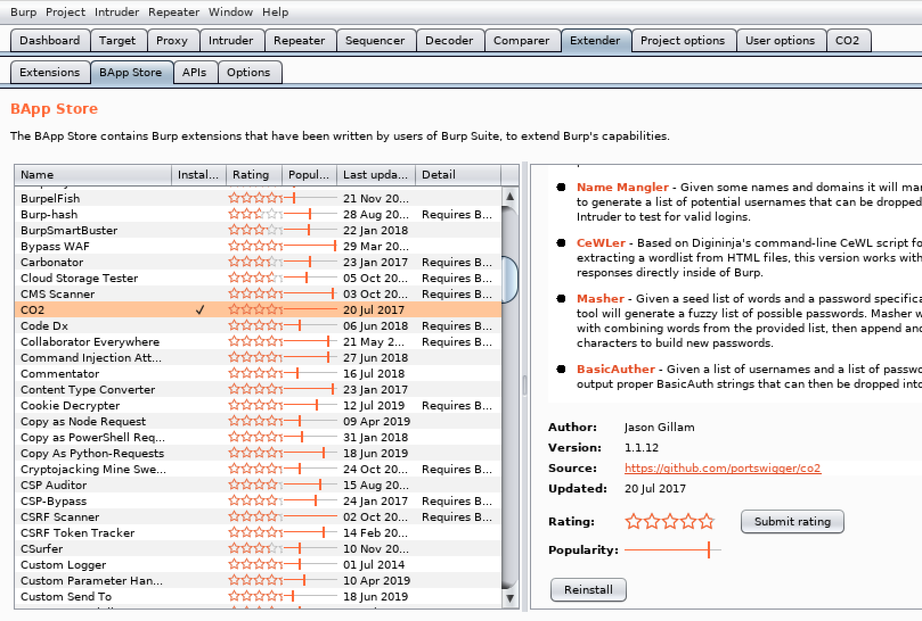
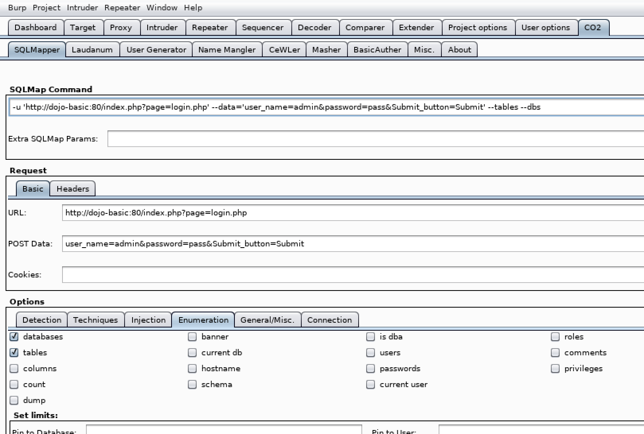
Burp CO2 Plugin
Notes:
Easy way to get parameters to sqlmap correct
Reduces typo errors within URL and form parameters
CTRL+Shift+C copies selected data in a terminal
CTRL+Shift+V pastes data into a terminal

Slide 77
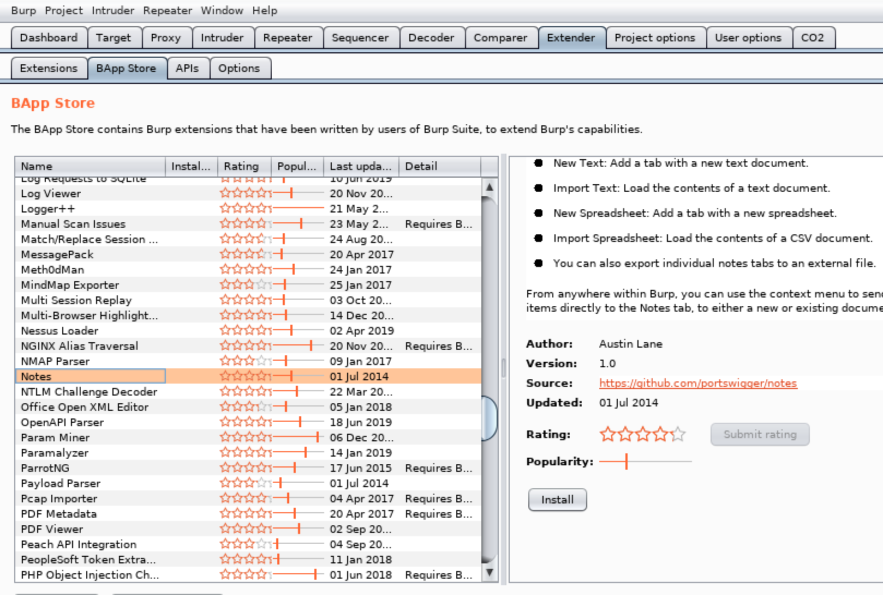
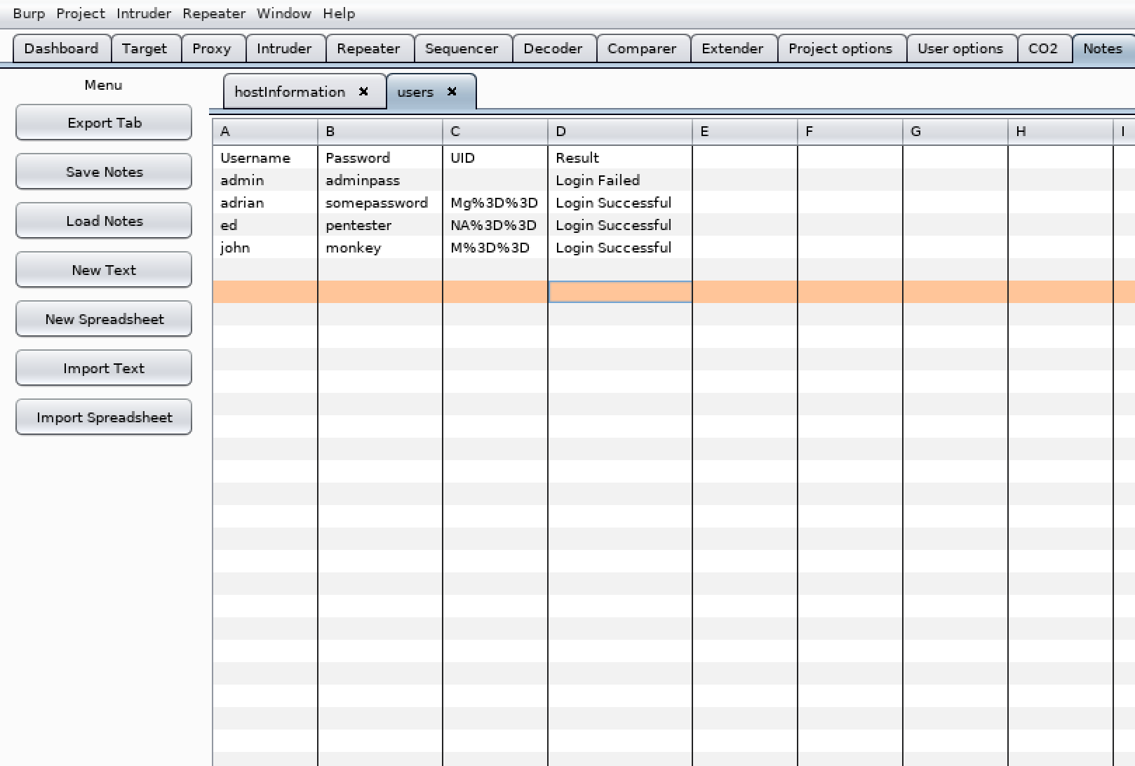
Burp Notes Plugin

Slide 78
Impacket – Stand Alone SMB server
# python smbserver.py -comment "this is not the drive you are looking for" ONE /root/Downloads/10/
Impacket v0.9.16-dev - Copyright 2002-2017 Core Security Technologies
[*] Callback added for UUID 4B324FC8-1670-01D3-1278-5A47BF6EE188 V:3.0
[*] Callback added for UUID 6BFFD098-A112-3610-9833-46C3F87E345A V:1.0
[*] Config file parsed
[*] Incoming connection (10.141.13.10,1346)
[*] AUTHENTICATE_MESSAGE (\,MIKE)
[*] User \MIKE authenticated successfully
[*] :::00::4141414141414141
[*] Disconnecting Share(1:PC10$)
[*] Disconnecting Share(2:ONE)
[*] Closing down connection (10.141.13.10,1346)
Notes:
Used with a Cold Fusion vulnerability. The admin panel for cold fusion had a scheduled task. Once the task failed it would perform an action. As you couldn’t upload files, I tried to load a file into memory using SMB. Made it easy to upload a reverse shell to the server.

Slide 79
Python Modules
Standalone HTTP server
Python2: python -m SimpleHTTPServer
Python3: python3 -m http.server
The HTTP server will allow files within the current directory to be served to a remote host.
Will not interpret PHP code
Simple Email Server: python -m smtpd –c EmailServerName -n localhost:1313

Slide 80
Hash Identifiers
Hash: AAFDC23870ECBCD3D557B6423A8982134E17927E
Use hash-id to determine the hash type, and view John The Ripper set string
# hashid -j AAFDC23870ECBCD3D557B6423A8982134E17927E
Analyzing 'AAFDC23870ECBCD3D557B6423A8982134E17927E'
[+] SHA-1 [JtR Format: raw-sha1]
Hash-Identifier: # hash-identifier AAFDC23870ECBCD3D557B6423A8982134E17927E
Possible Hashs:
[+] SHA-1
[+] MySQL5 - SHA-1(SHA-1($pass))

Slide 81
Cracking Hashed Passwords
Use John The Ripper JtR or HashCat
Copy the hash into a file:
# echo AAFDC23870ECBCD3D557B6423A8982134E17927E > adminHash.txt
# john --format="Raw-SHA1" --wordlist=/usr/share/wordlists/rockyou.txt adminHash.txt
Using default input encoding: UTF-8
Loaded 1 password hash (Raw-SHA1 [SHA1 128/128 AVX 4x])
Warning: no OpenMP support for this hash type, consider --fork=4
Press 'q' or Ctrl-C to abort, almost any other key for status
pass123 (?)

Slide 82
Medusa
Medusa is a speedy, parallel, and modular, login brute-forcer.
List all modules
# medusa -d
# medusa -h 10.10.10.10 -u admin -P password_file.txt -M http

Slide 83
NCrack
Ncrack is a high-speed network authentication cracking tool. From the Nmap team.
Useful for SSH, RDP, FTP, Telnet, HTTP(S), POP3(S), IMAP, SMB, VNC, SIP, Redis, PostgreSQL, MySQL, MSSQL, MongoDB, Cassandra, WinRM and OWA.
# ncrack -vv --user username -P paasword_file.txt rdp://10.10.10.10

Slide 84
Hydra
Network logon password brute force cracker
Useful against
Cisco AAA, Cisco auth, Cisco enable, CVS, FTP, HTTP(S)-FORM-GET, HTTP(S)-FORM-POST, HTTP(S)-GET, HTTP(S)-HEAD, HTTP-Proxy, ICQ, IMAP, IRC, LDAP, MS-SQL, MySQL, NNTP, Oracle Listener, Oracle SID, PC-Anywhere, PC-NFS, POP3, PostgreSQL, RDP, Rexec, Rlogin, Rsh, SIP, SMB(NT), SMTP, SMTP Enum, SNMP v1+v2+v3, SOCKS5, SSH (v1 and v2), SSHKEY, Subversion, Teamspeak (TS2), Telnet, VMware-Auth, VNC and XMPP
# hydra -L root -P password_file_list.txt 10.10.10.10 ssh

Slide 85
WordPress Scanner
WPScan scans WordPress sites for themes, plugins, users and vulnerabilities
# wpscan --url https://wordpress-site.com -e ap,at,tt,cb,dbe,u,m -U user_list -P pass_list

Slide 86
Joomla Scanner
Scan Joomla web pages
Not part of default Kali toolset, install using apt:
# apt install joomscan
# joomscan -ec -u http://target.com/joomla

Slide 87
Drupal Scanner
Scan Drupal web pages
Not part of default kali tools, Install:
# git clone https://github.com/droope/droopescan.git
# cd droopescan/
# apt install python-pip
# pip install -r requirements.txt
# ./droopescan scan drupal -u https://drupal-site.com -e a

